Slide 1

Toronto 311 Service Customer Initiated Data Visualization

Slide 2
Agenda
Introduction
Total Service Requests Received
Weekly Status
Peak Hours
Naughty Wards
Busy Hour for Wards
Area v/s Service Request Type
Quarterly Analysis
Conclusion

Slide 3
Introduction
311 manages City divisional service request data for Solid Waste Management, Transportation Services, Toronto Water, Municipal Licensing & Standards, and Urban Forestry.
The report focuses on the usage of 311 Service Requests - Customer Initiated.
For the course of completion of this report, dataset from the following link has been selected:
https://open.toronto.ca/dataset/311-service-requests-customer-initiated/
Data for the year 2018 has been opted and patterns are visualized.
Visualization tools used: Tableau [95%] and Power BI [5%].

Slide 4
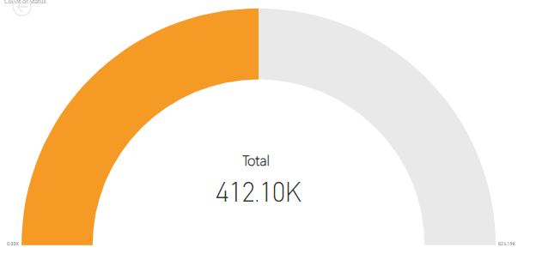
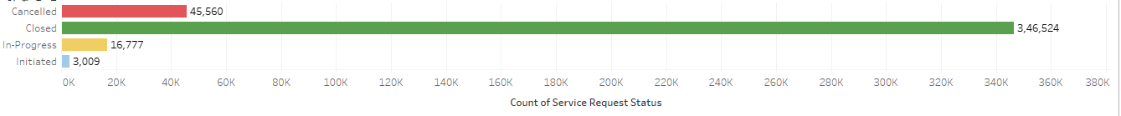
Total Service Requests Received
During the year 2018, a total of 412.10K service requests were registered.
The status of only 3,46,524 requests was reported to be closed.
Out of the total, 45,560 requests got cancelled.

Slide 5
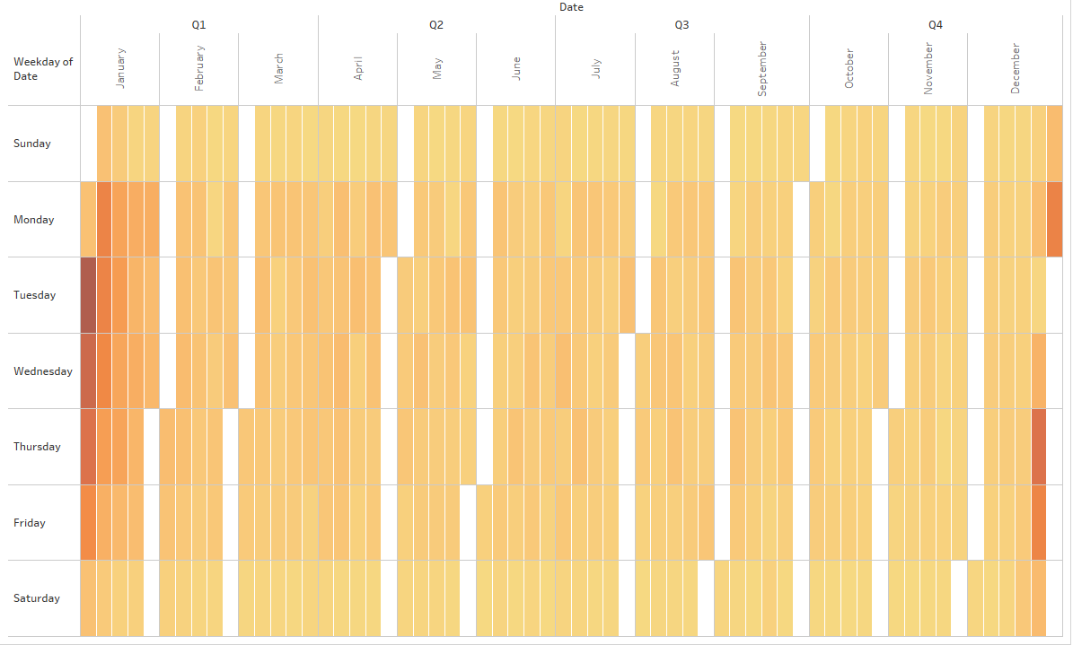

Weekly Status
When comparing the weekly trends for each month using heat map, it was observed that Tuesdays, Wednesdays and Thursdays happen to be the busiest days of the week.
Weekends were generally slow in terms of receiving the requests.

Slide 6
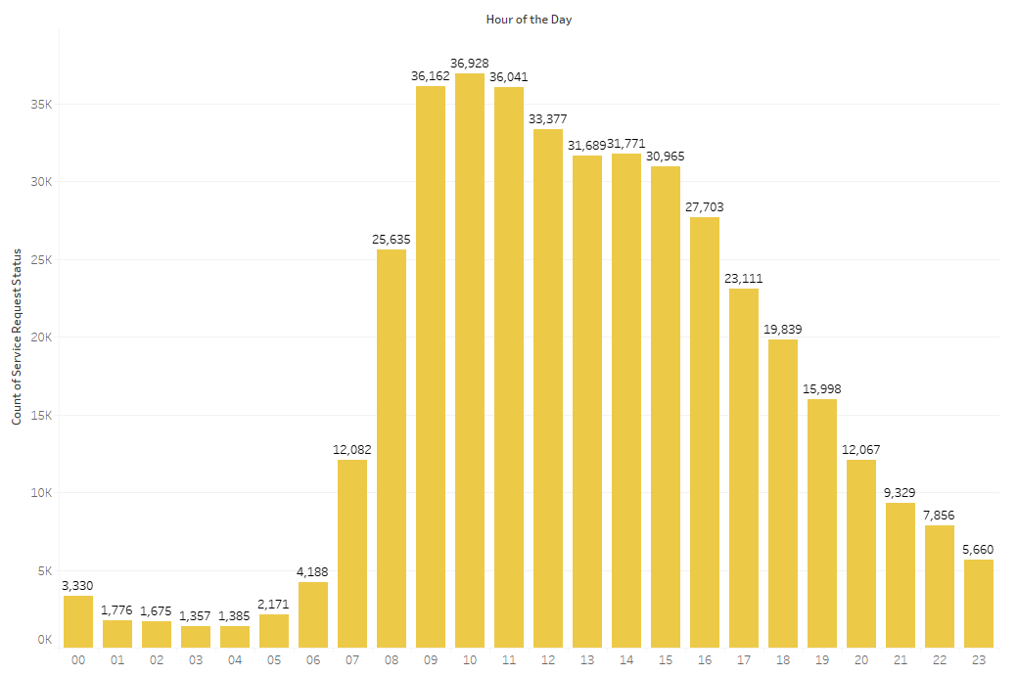
Peak Hours
Morning hours from 9 am to 11 am were busy hours for 311 representatives as they have received a lot of requests during this time interval.
Surprisingly, even during night hours after 12 and before 6 in the morning, there were certain number of 311 requests received.

Slide 7
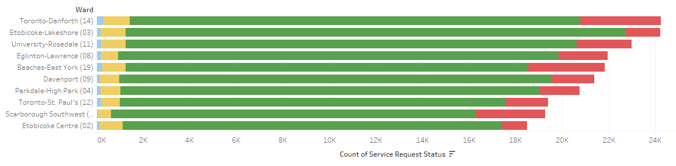

Naughty Wards
Top 10 wards that often use 311 helpline were reported.
Toronto-Danforth ward topped the list for using 311, the most. It also had a high request cancelled rate associated with it.
Ward Etobicoke-Lakeshore was observed to be second on the list with a comparatively better request completion rate.

Slide 8

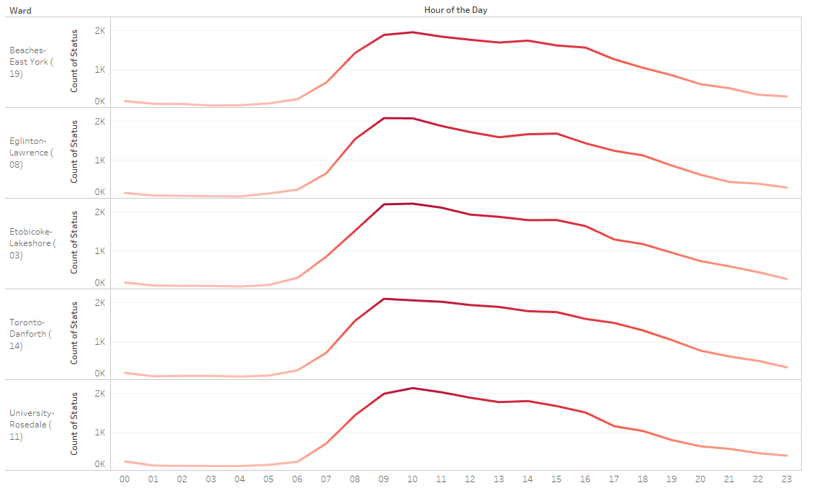
Busy Hour for Wards
Trend of top 5 wards making 311 requests was plotted.
All the wards demonstrate a general trend of becoming active from 9 am to 11 am and then reducing slowly towards the end of the day.

Slide 9
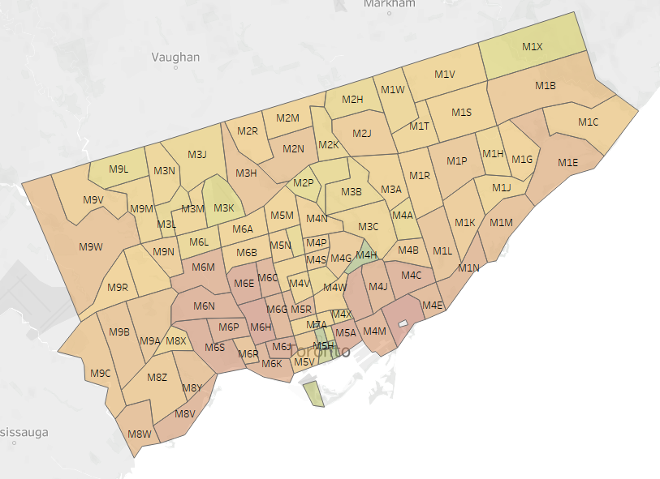

Area v/s Service Request Type
Map was plotted to observe the type of service request raised by each postal are in the city of Toronto.
The city vividly used 311 helpline for several type of requests.
Rarely there is any area which didn’t use the helpline.

Slide 10
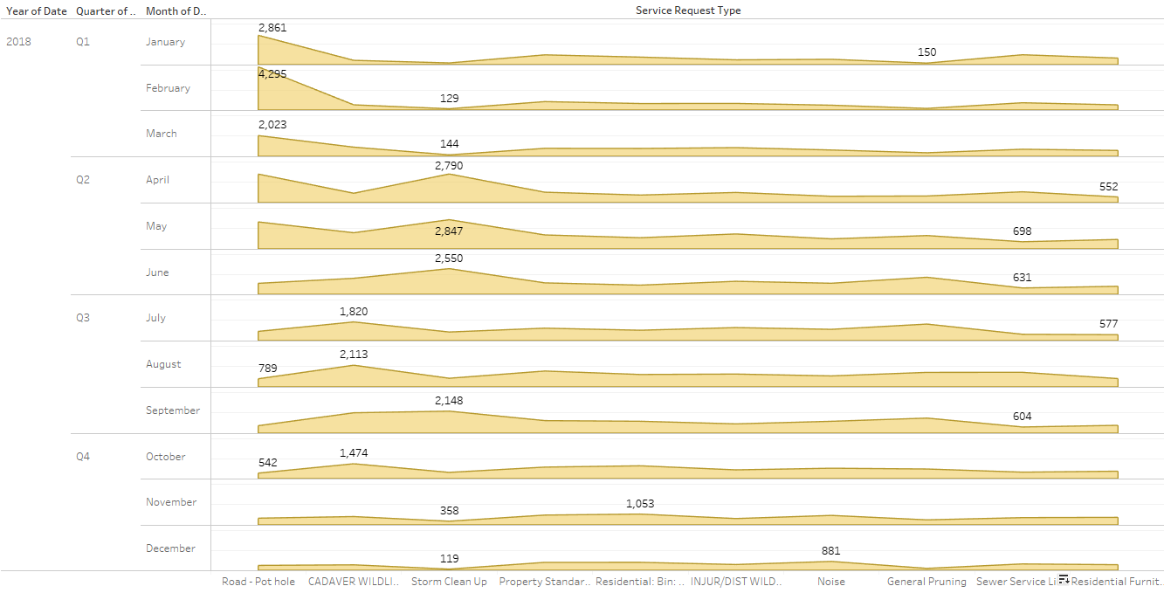
Quarterly Analysis
It is interesting to see how the people report problems on a monthly basis.
With Road-Pot hole problem being the highest in first quarter, it is nowhere in picture in the last quarter. Snow is one possible reason for the same.
In 2nd quarter, storm was a major reason.
In 3rd quarter, people had to deal with wildlife.
Last quarter observed high request rate due to noise, may be due to end of year celebrations.

Slide 11
Conclusion
After plotting several charts and observing the behaviour of customers based on wards, postal area, service requests type, it can be concluded that 311 was used extensively during the year 2018.
Round the clock implementation was observed for this helpline, which reveals that the helpline is very beneficial for the audience of city of Toronto.
However, employing more number of people during peak hours would benefit both, the stakeholders for the helpline and the general addressees.
People can be hired based on the request type and the season in order to compensate the requests or to take preventive measures beforehand.

